Slide 1
Introducción a R y RStudio
Ricardo Ahumada O
Unidad de Planificación Sanitaria
DGR - SSMS
* Modificada de Joseph Rudolf. R/Medicine. 2022
* Con adiciones de https://www.r4epi.com

Slide 2
Ciencia de datos
“La ciencia de datos es un campo académico interdisciplinario que utiliza estadística, computación científica, métodos, procesos, algoritmos y sistemas científicos para obtener (recolectar o extraer), tratar, analizar y presentar informes a partir de datos ruidosos, estructurados y no estructurados.​ La ciencia de datos es multifacética y puede describirse como una ciencia, un paradigma de investigación, un método de investigación, una disciplina, un flujo de trabajo o una profesión”.
https://es.wikipedia.org/wiki/Ciencia_de_datos

Slide 3
Programar
La programación es el proceso de crear un conjunto de instrucciones que le dicen a una computadora como realizar algún tipo de tarea. Pero no solo la acción de escribir un código para que la computadora o el software lo ejecute. Incluye, además, todas las tareas necesarias para que el código funcione correctamente y cumpla el objetivo para el cual se escribió.
En la actualidad, la noción de programación se encuentra muy asociada a la creación de aplicaciones de informática y videojuegos. En este sentido, es el proceso por el cual una persona desarrolla un programa, valiéndose de una herramienta que le permita escribir el código (el cual puede estar en uno o varios lenguajes, como C++, Java y Python, entre muchos otros) y de otra que sea capaz de “traducirlo” a lo que se conoce como lenguaje de máquina, que puede "comprender" el microprocesador.
https://es.wikipedia.org/wiki/Programaci%C3%B3n

Slide 4
Por qué aprender a programar en ciencia de datos
Pensamiento lógico y resolución de problemas (método).
Te entrega una nueva alternativa a evaluar para el desarrollo de una tarea.
Reduce tiempo en tareas repetitivas (al principio toma tiempo)
SALIR DEL COPIAR Y PEGAR
Permite conocer el proceso de análisis de información. Se guarda el flujo.
TRAZABILIDAD – ENTENDER LO QUE SE HACE – ACTUALIZAR INFORMACIÓN
Es un lenguaje – permite la comunicación con la computadora y con otras personas.
COLABORACIÓN y REPRODUCIBILIDAD (por ejemplo: en publicación científica)

Slide 5


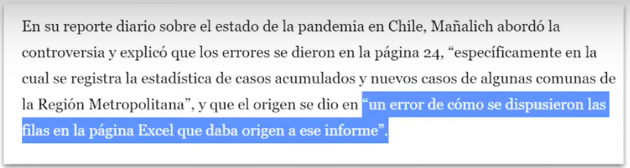

Slide 6
«Los problemas comunes son sencillos...
Error de indexación (se corrieron las filas del Excel)
Error de etiquetado de repeticiones (Me equivoqué donde empezar a pegar)
Fuentes de datos utilizadas no declaradas (¿De dónde copié los datos?)
Cifras incorrectas por cálculos manuales (Se me pasó un cero, dividí al revés)
y los problemas sencillos son frecuentes».

Slide 7
Point-and-click no es reproducible
El código puede documentar con precisión cada paso del análisis

Slide 8
¿Por qué debo analizar los datos de forma reproducible?
¿Podemos rehacer el análisis con los datos de este mes?
¿Por qué los datos de la tabla 1 no parecen coincidir con los de la figura 2?
¿Por qué decidí omitir estas seis muestras de mi análisis?
Colabora contigo mismo/misma hoy,
hace 6 meses o en dos años más.
Notes:
But reproducibility doesn’t only help others. Consider the following 3 statements and ask yourself if they sound familiar.
-Can we redo the analysis with this month’s data?
-Why do the data in Table 1 not seem to agree with Figure 2?
-Why did I decide to omit these six samples from my analysis?
**Your closest collaborator is you from 6 months ago. You can do yourself a huge favor by using tools that promote reproducibility.
And if you are analyzing clinical data and might affect patient management or public health based on your findings, that makes it so much more important that you take steps to assure your analysis is documented, free of errors, and reproducible by others.

Slide 9
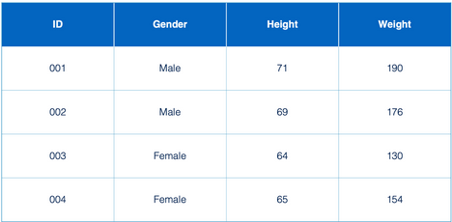
¿Qué es un dato?
Columnas = Variables
data <- “información sobre objetos y fenómenos observables” %>%
“la data se guarda como una colección de símbolos, números, letras, etc” %>%
“típicamente, se almacena en un dataframe”
Filas = Repeticiones
Cell/Celda/Casilla
Valores/Values

Slide 10
¿Qué es R entonces?
R es un lenguaje de programación estadística de código abierto que fue creado en la década de 1990 por Robert Gentleman y Ross Ihaka específicamente para el análisis de datos.
“R es como una manera fácil de pedirle a tu computadora que haga matemáticas y estadística por ti”

Slide 11



R
Lenguaje de programación usado fundamentalmente para análisis estadístico.
RStudio
Ambiente de Desarrollo interactivo (IDE) que facilita el uso de R.

Slide 12
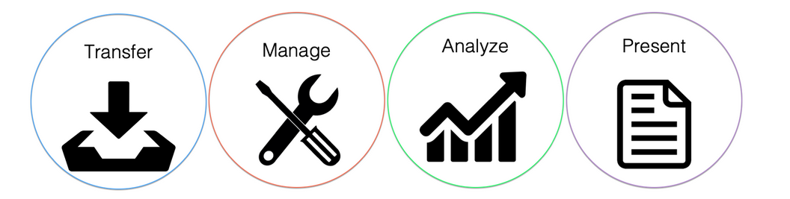
¿Qué Me permite hacer R?

Slide 13
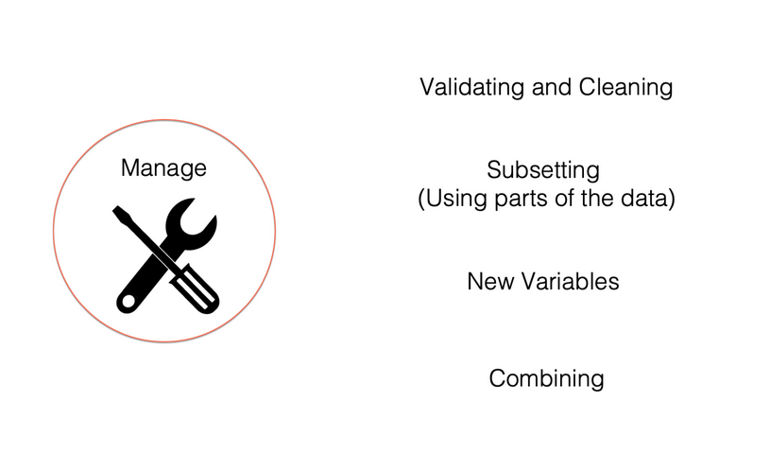
Gestionar los datos

Slide 14
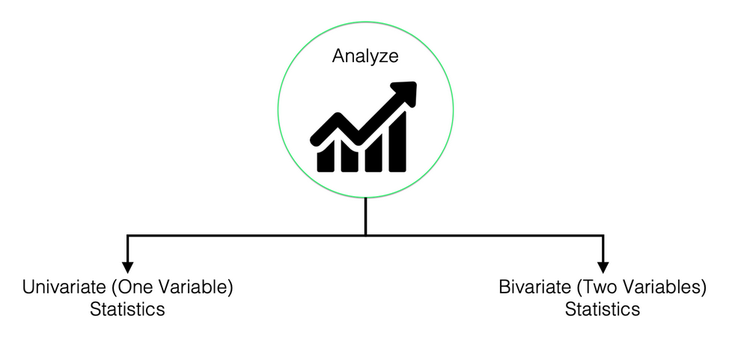
ANALIZAR los datos
Medidas de tendencia central: media, mediana y moda.
Medidas de dispersión: varianza y error estándar.
Medidas para describir variables categóricas: recuentos y porcentajes.
Descripción de datos mediante gráficos y diagramas: gráficos bonitos e informativos.
Otras

Slide 15
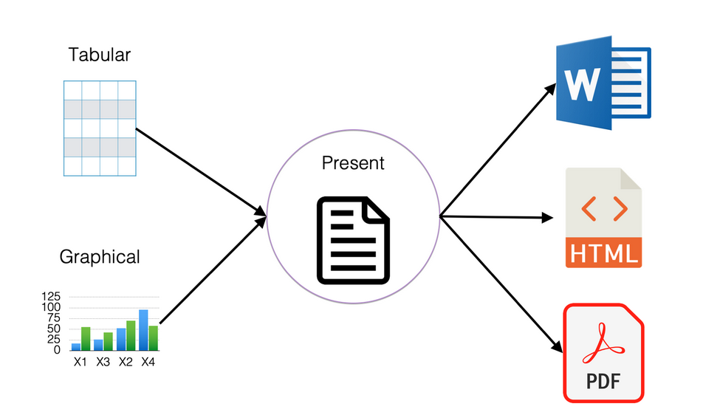
PREsentar los datos

Slide 16
Empezando con r-studio

Slide 17

Formatos de r-studio
RStudio Server
Para uso en la nube
RStudio Desktop
Instalado en el computador

Slide 18
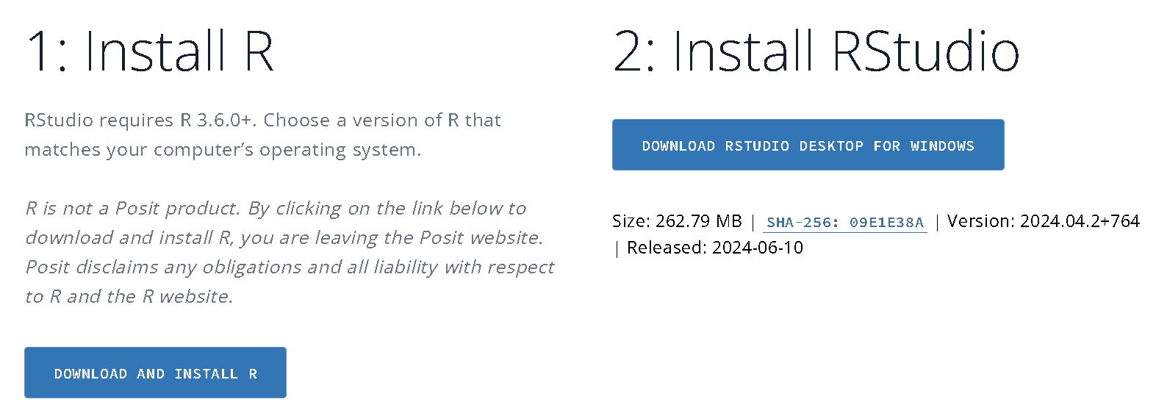
Instalar r y r-studio
https://posit.co/download/rstudio-desktop/

Slide 19
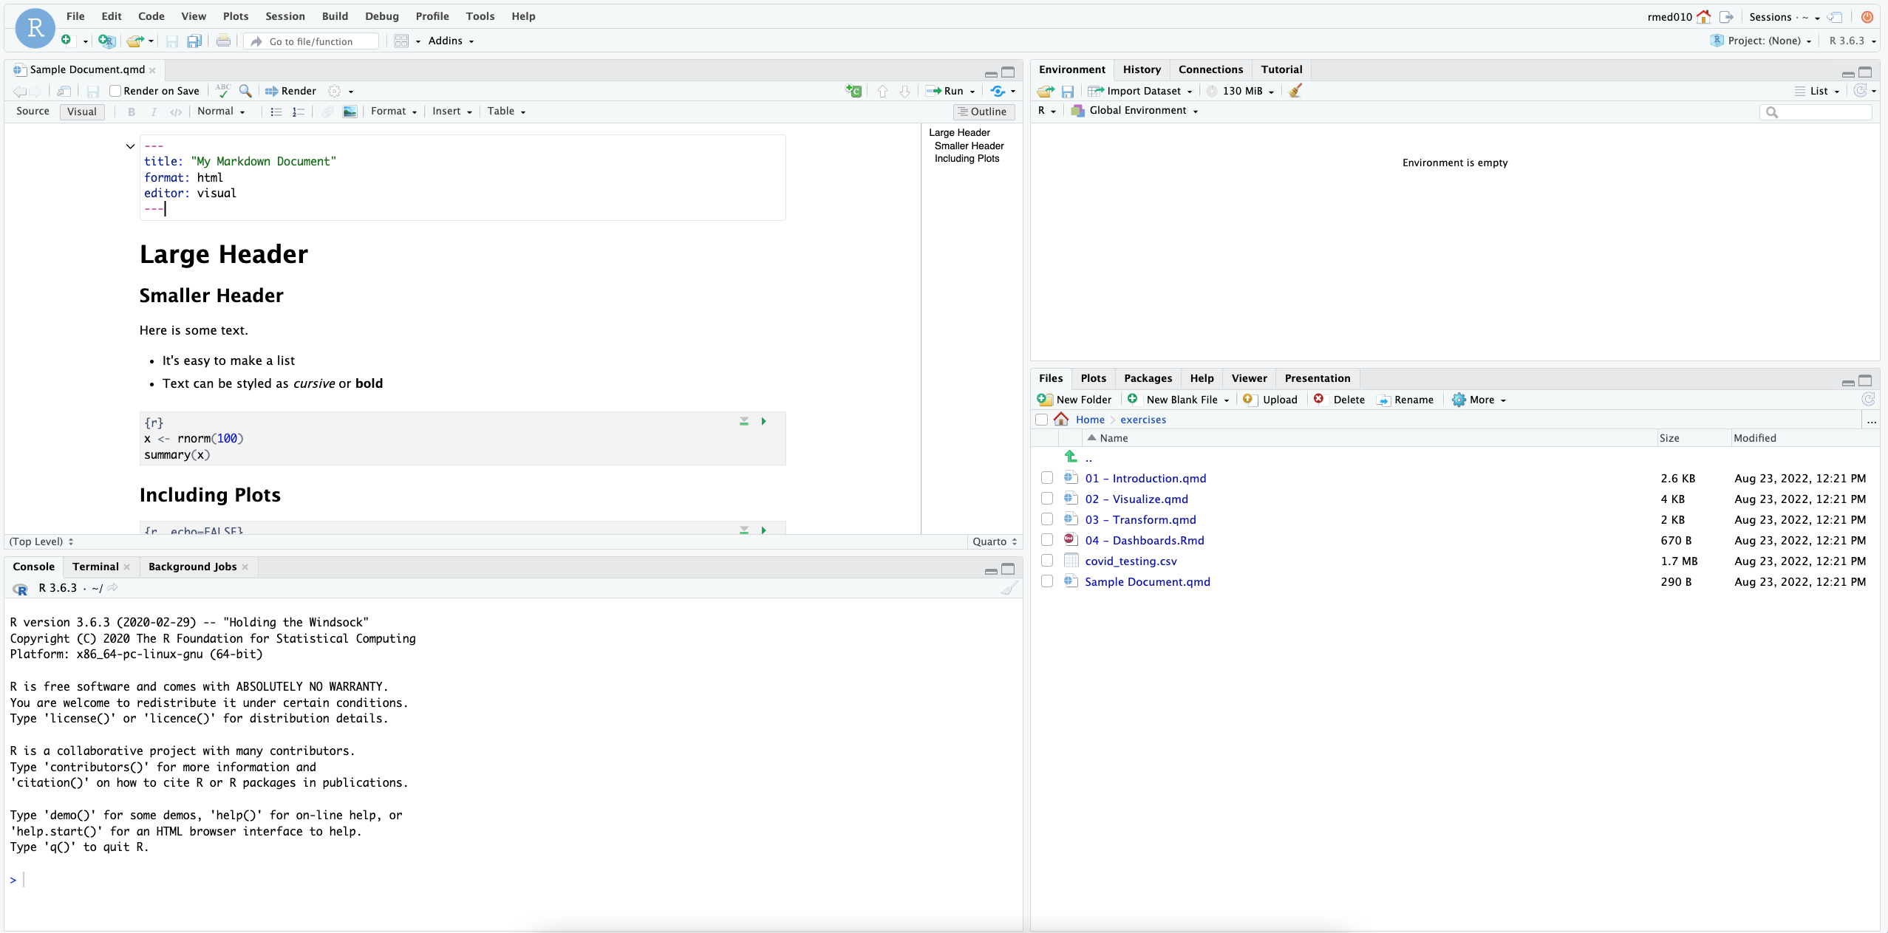
Ambiente
Editor de código
Consola
Varios

Slide 20
Tipos de dato

Slide 21
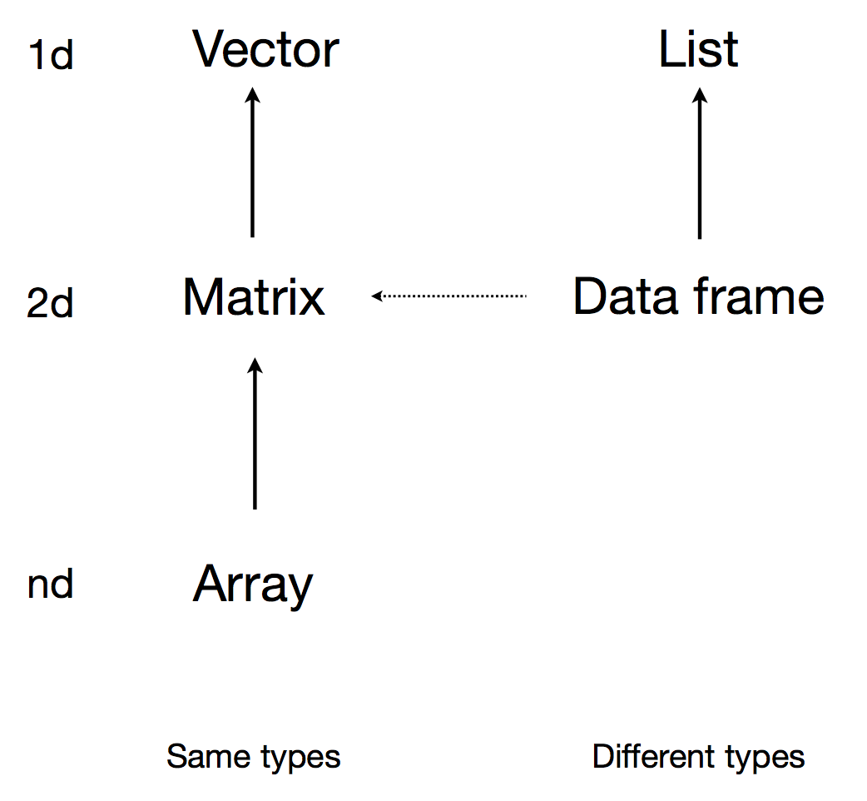
Tipos de dato

Slide 22
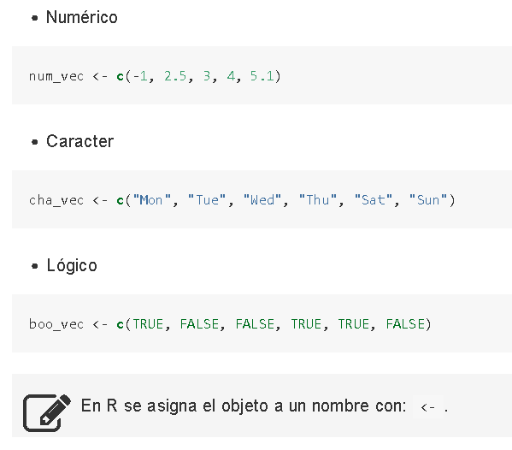
1. Vectores
class()
lenght()
c()

Slide 23
funciones

Slide 24
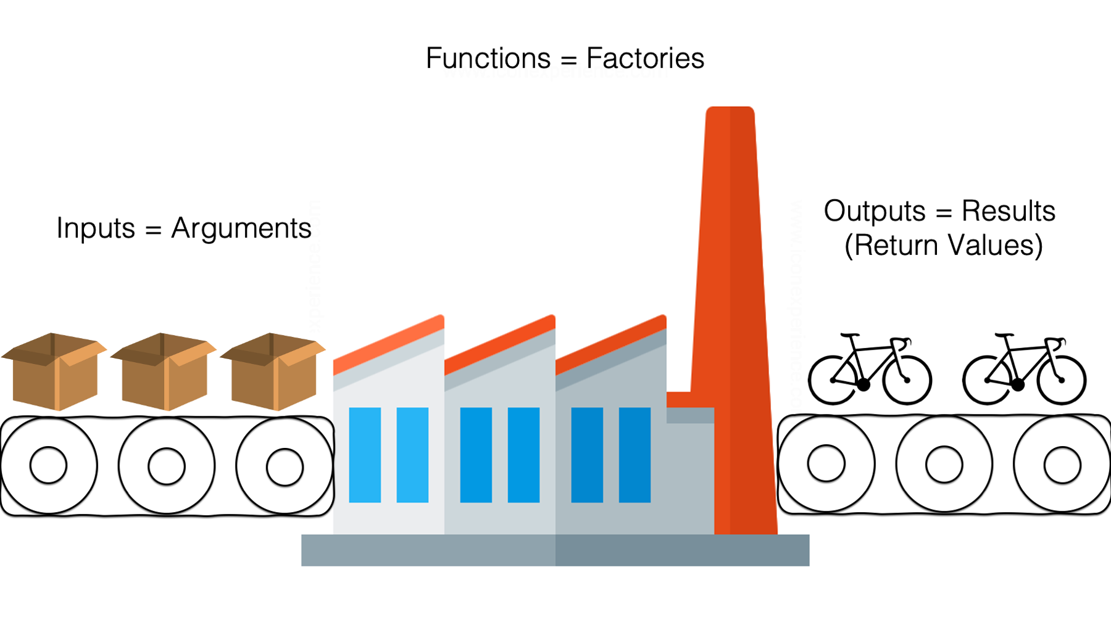

Slide 25
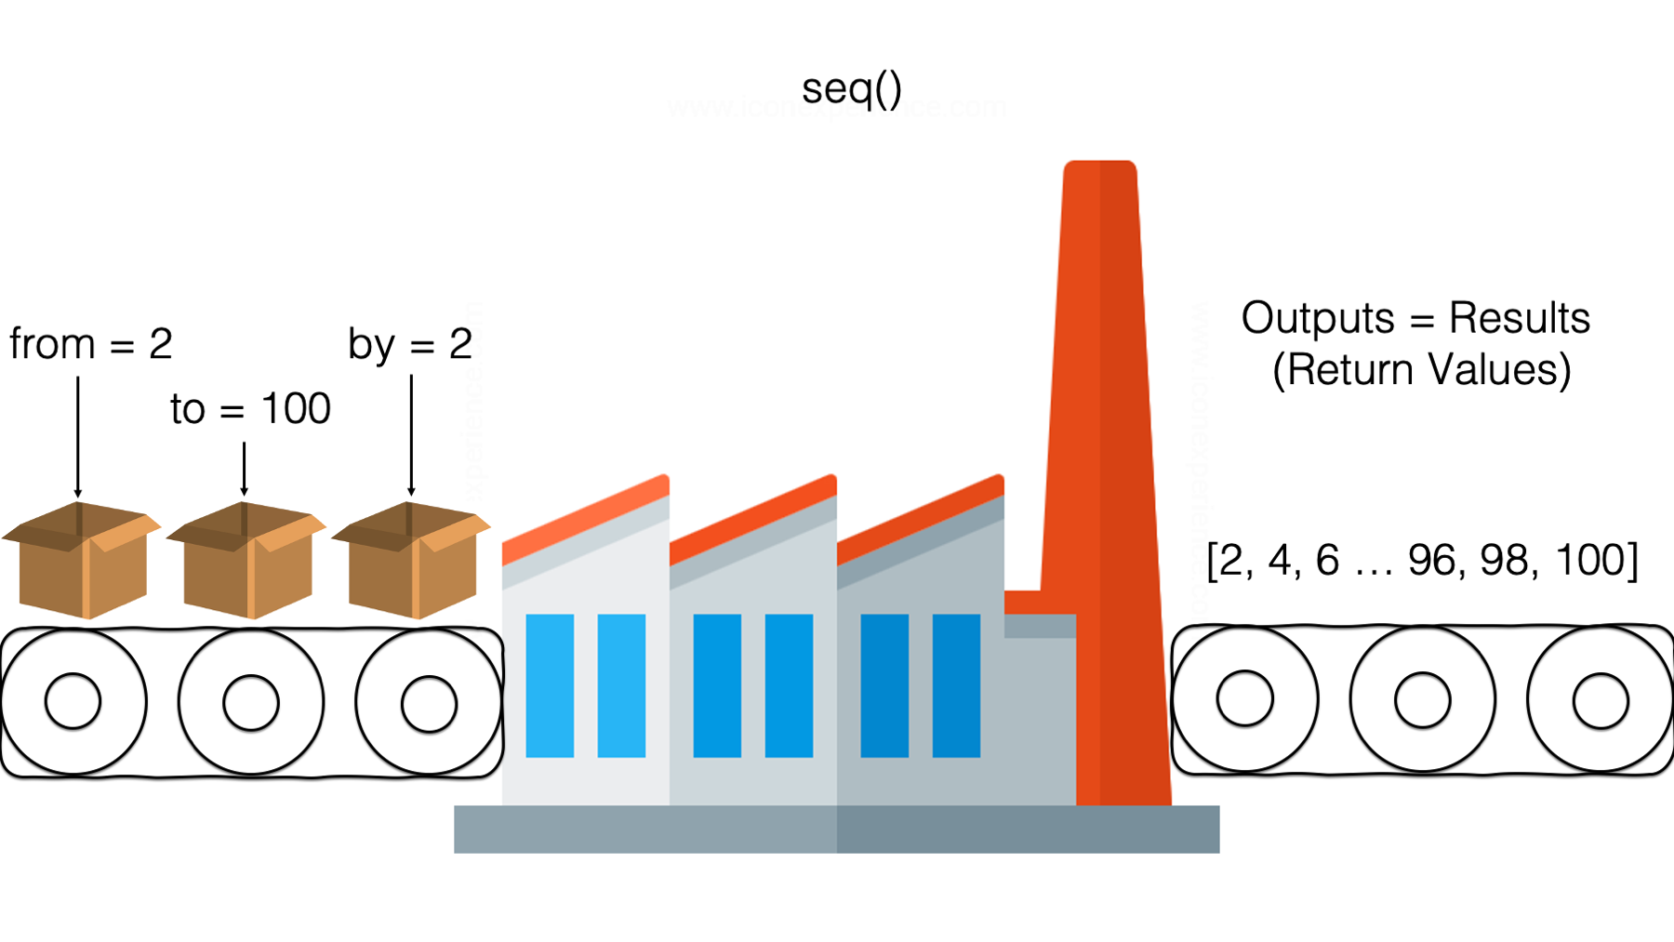

Slide 26
Objetos

Slide 27
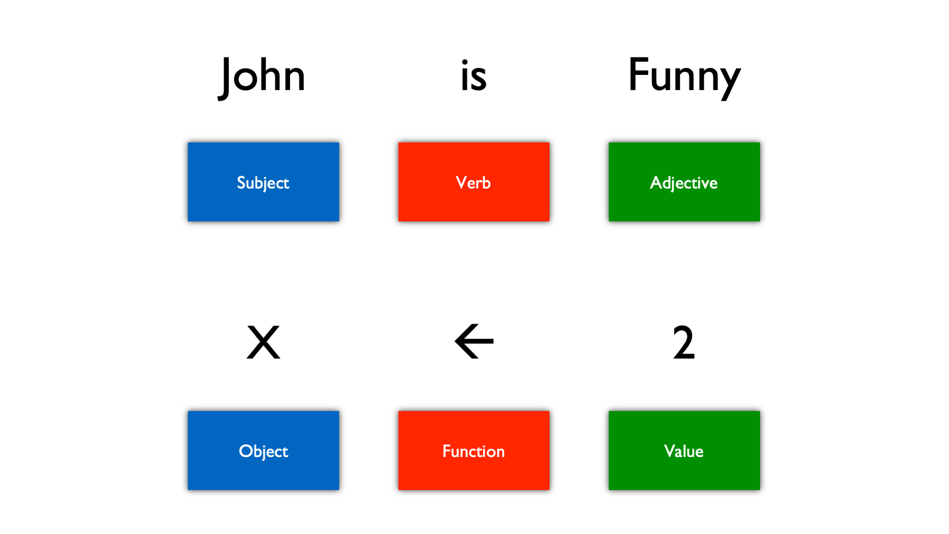

Slide 28
librerías

Slide 29
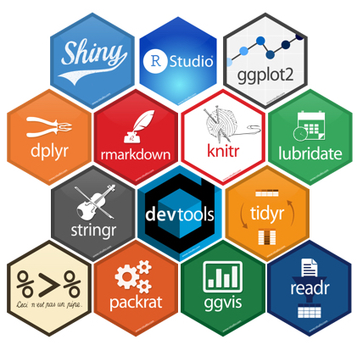
¿qué son las librerías?

Slide 30
Importar datos
Notes:
Now that we are familiar with how to create Quarto documents we can begin the process of performing data analysis in R in earnest by importing a clinical data set.

Slide 31
The Data Analysis Pipeline
Notes:
This diagram may look familiar, you saw it in the Welcome presentation.
The first step in the data analysis pipeline is to load (**) the data into the environment so we can begin to tidy and transform that data.
In today’s course we will be using a de-identified data set consisting of COVID-19 laboratory test results from a microbiology lab. This data is stored as a CSV file.

Slide 32

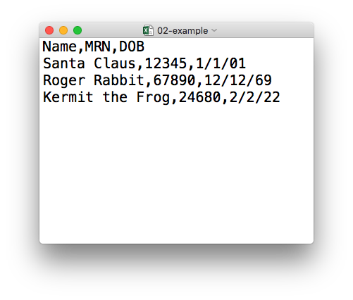
plain text (“flat”) file
csv
rectangular structure
header row
Notes:
So what’s a CSV file? CSV stands for comma-separated values.
** A CSV file is a plain text file, which means you can open it in a text editor and look at it.
Here we have a CSV file with the names, medical record numbers, and dates of birth for three fictional “patients”
** This data structure is called rectangular because it falls into rows and columns, where each row has the same # of columns, and each columns has the same # of rows.
** Also note that this particular CSV file has a header row that instead of data, has a descriptor of what kinds of data are found in each column. CSV files often but not always have such a header row.

Slide 33
Tidyverse: Paquete de R para Ciencia de Datos
Organizar data de manera consistente
Código simple de lectura humanada
Construir flujos (pipelines) según los pasos definidos para el manejo de datos
Notes:
To import our CSV data, we need some additional data analysis tools. In this course, we will be leveraging the Tidyverse.
The Tidyverse is a modern set of tools for data analysis in R. It’s quickly becoming the de facto standard for doing data science with R.
The basic tenets of “tidy” data analysis include:
Data should be organized in a consistent, standardized way. Each row is an observation, and each column is a variable. This is a very common way to organize data in a spreadsheet and might sound familiar from how you may already organize data in tools like Excel.
Programming code that acts on the data should be consistent, concise, and mimic the narrative language as much as possible.
Each data analysis can be broken down into a series of atomic steps, such as “select this column” or ”arrange the data by the values in that column”. Accordingly, an arbitrarily complex data analysis can be broken down as a pipeline of atomic steps.

Slide 34
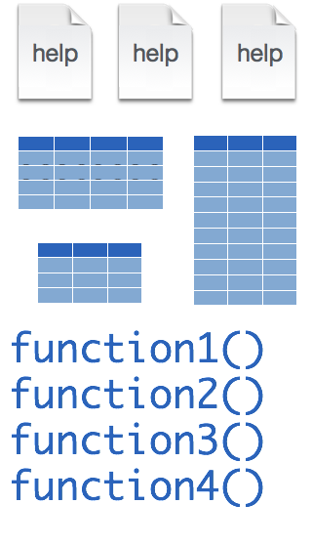
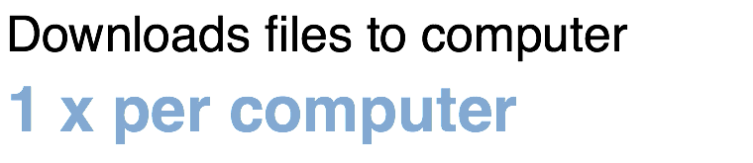
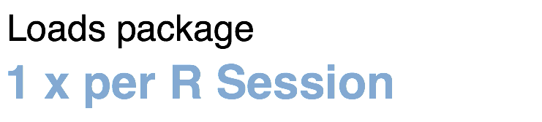
Installing and loading R packages
tidyverse
install.packages("tidyverse")
library("tidyverse")
Notes:
The Tidyverse is package (a collection of functions, data, and help documentation) that we can use to extend the functionality of R.
Packages need to be installed explicitly – with the command install.packages. So let’s say you want to install a package named “tidyverse”. You go to the R Console and type install.packages(“tidyverse”).
Each package you want to use needs to be installed only once on each computer. However, in order to use the functions or data in the package, you also need to load the package. This is done with the command “library”. So to enable all the functions in the “tidyverse” package, you type library(“tidyverse”). Packages remain loaded until you quit R. So every time you start a new R session you have to load each package that you want to use again.
On our RStudio Server, you won’t need to install any packages for this course (we have installed them for you). But at times in this course you’ll need to load packages. We’ll practice this later.
So these are the first two R commands we’ve covered - install.packages and library.

Slide 35

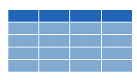

read_csv()
data_frame <- read_csv(file_name)
csv
Notes:
Once, the Tidyverse package has been loaded via library, we can import CSV files using the read_csv() function.
Here is a template for how to use the read_csv function to create a data frame object from a CSV file.
You start with the name of a data frame object then you have this left-ward arrow then read_csv and then the file name in parentheses.

Slide 36
function
(does stuff)
data_frame <- read_csv(file_name)
Notes:
This code construct is exceedingly common in R, so I want to spend a few minutes exploring it together
read_csv() is a function. Remember that functions are defined in packages. We loaded the Tidyverse package to be able to use the read_csv function.
You may be familiar with functions from math class. A function takes an input, say an ‘x’ value and returns an output, say a ’y’ value. Functions in computer programming also take inputs and return outputs. But the inputs and outputs here are the arguments and objects that exist within the context of a programming language.
For read_csv, the input is the file name of a CSV file; and the output is a data frame with the contents of the file.

Slide 37
function
(does stuff)
argument
(input)
data_frame <- read_csv(file_name)
Notes:
The input that goes into a function is called an argument. The argument to a function gets put in parentheses.
A function can have zero, one, or many arguments. If there is more than one argument, we use commas to separate them. We’ll see examples of that later.

Slide 38
object
(stores output)
function
(does stuff)
argument
(input)
data_frame <- read_csv(file_name)
Notes:
- The read_csv function outputs a data frame (think table), but if we want to *capture* that data frame inside of a named object, we need to specify that explicitly. It is a great idea to capture the output of a function in an object so it can be used as the input for other functions, for example to summarize or visualize the data in the named object.

Slide 39
object
(stores output)
function
(does stuff)
argument
(input)
data_frame <- read_csv(file_name)
assignment operator
(“gets”)
Notes:
To put the output of the read_csv function into a named object, we use the assignment operator.
The assignment operator is a smaller-than followed by a dash or minus and looks kind of like an arrow pointing left. It’s usually read as “gets.”

Slide 40
read_csv()
data frame to read data into
name of
CSV file
covid_testing <- read_csv("covid_testing.csv")
covid_testing
covid_testing.csv
csv
Notes:
Let’s put these pieces together to load our covid data set.
This line of code reads the “covid_testing object gets the output of the read_csv function on the covid_testing CSV file”.
You might notice that one of the objects is put in quotes and the other one isn't.
To be honest, quotes can be confusing. Names of objects such as data frames don't get quotes. In contrast, literal file names are always put in quotes. This is part of the grammar of coding (the syntax) in R that will become more familiar to you as you develop proficiency and comfort with the language.

Slide 41


Recap
Programming Language
Document Format
IDE
Packages extend the functionality of R. They need to be installed once per computer and loaded each session.
Functions do stuff. They accept Arguments to define parameters. We can store the output of functions in Objects using the assignment operator ( <- ).
Importing Data is the first step data analysis pipeline. read_csv() is a function from the tidyverse that we can use for importing data.

Slide 42
Consejo!
Notes:
At the end of each lesson we have included a what else section to introduce you to ”what else” you may want to explore and learn about after completing this course.
This includes helpful hints, other functions in the Tidyverse, and exciting packages you may want to check out.

Slide 43
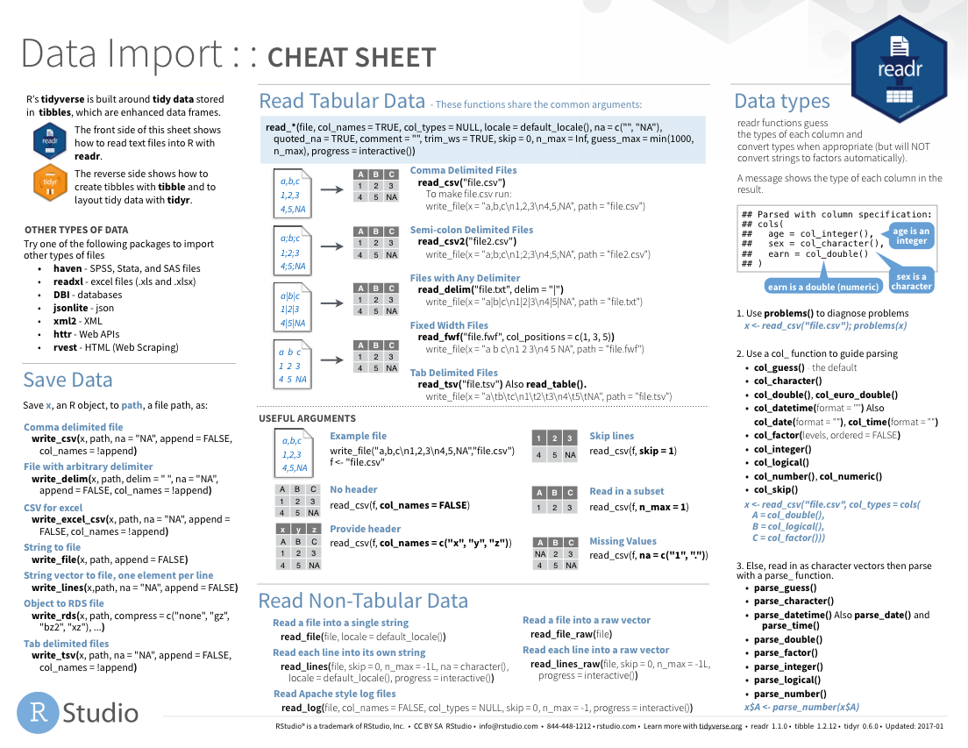
Notes:
The Data Import cheat sheet helps with the grammar of importing data including other file types and those with other separators (like pipes “|” instead of commas).
The Data Import cheat sheet is available on the RStudio website.

Slide 44
Notes:
There are a variety of other packages out there designed to deal with different file formats:
Readxl: Excel
Haven: SPSS, Stat, SAS files
Googlesheets
Rvest: scrape the web
Jsonlite: JSON data and APIs on the web

